Slide 1
Coordinator Election

Slide 2
Coordinator Election
Many of the approaches in distributed computing involve a "special" machine that has a unique role or purpose within the system.
Consider the Time Server for time synchronization
The server that polls each machine and synchronizes time
It is not sufficient that the special machine is "appointed" by an administrator, as distributed systems need to re-appoint another special machine in the event of a failed coordinator.

Slide 3
Election is not Synchronization
When it comes to synchronization, the selected process needs to know that it can enter the critical section. The other processes need not know that they cannot enter the critical section.
It is not necessary for any process, other than the selected process, to know who has been selected.
On the contrary, all participants must know which process is the coordinator.

Slide 4
Election is not Synchronization
Fault tolerance is of secondary importance to Synchronization. In contrast, election is typically required in the event of a fault.

Slide 5
Bully Algorithm
Assumptions
All messages are delivered within T(m) time. This is called message propagation time.
Once a message is received, a reply will be sent within T(p) time. This is called message handling time.
T(m) and T(p) are known.

Slide 6
Bully Algorithm (Exercise)
Based on the assumptions stated in the previous slide, what is the maximum amount of time needed to receive the response for a sent message?
Ans: 2T(m) + T(p)

Slide 7
Bully Algorithm
Given that T(m) and T(P) are known, it is possible to detect when a machine has faults, i.e., unable to communicate.
How?
Through the help of timeouts. Expect maybe 2x of the time

Slide 8
Bully Algorithm (Protocol)
When a processor P_{i} suspects that the coordinator has failed (e.g. by communicating and receiving no response within time), it tries to elect itself as the coordinator.
P_{i} sends message to all other processors P_{j} that have higher IDs (i.e. j > i) stating that P_{i} is the new coordinator.
If any P_{j} (for j > i) answers, then P_{i} loses the election.

Slide 9
Bully Algorithm (Protocol)
Objective is to elect the available processor/machine with the highest ID. This will be the coordinator.

Slide 10
Bully Algorithm (Protocol)
When P_{j} (for j > i) receives the message from P_{i,} it answers P_{i,} calls an election and try to win itself as a coordinator.
Note that the answer to P_{i} means that P_{i} loses the election eventually.

Slide 11
Bully Algorithm (Protocol)
If no P_{j} (for j > i) answers, then P_{i} wins the election and declares itself as the coordinator.
P_{i} then sends message to all P_{k} (k < i) stating that P_{i} is the new coordinator.

Slide 12
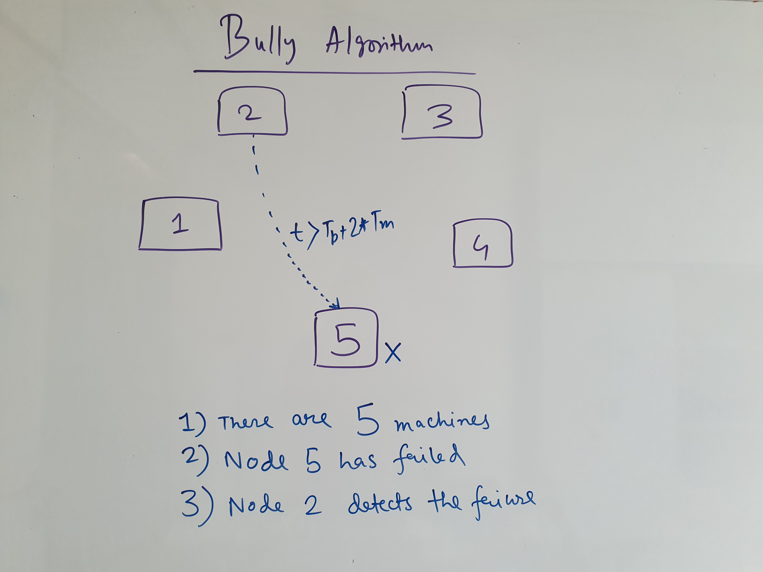

Slide 13
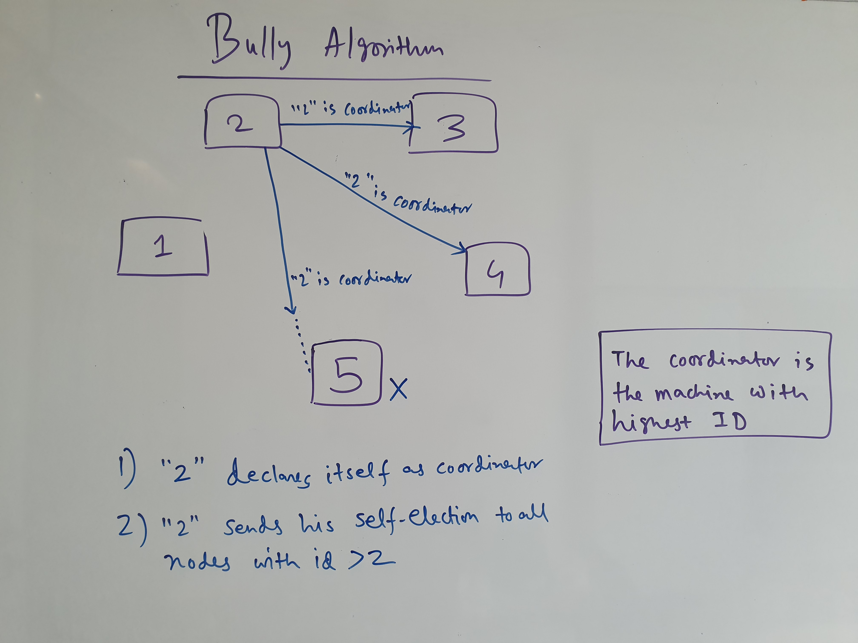

Slide 14
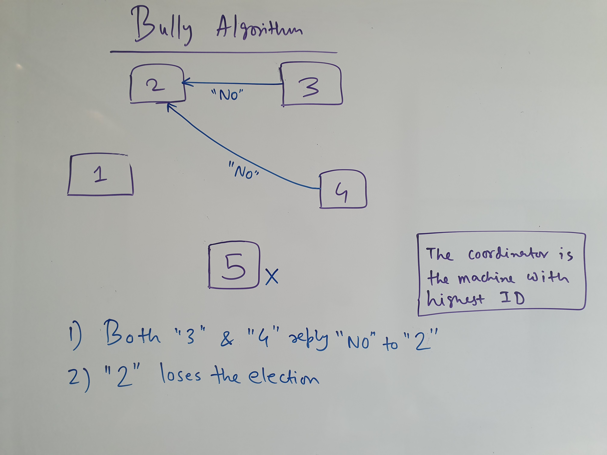

Slide 15
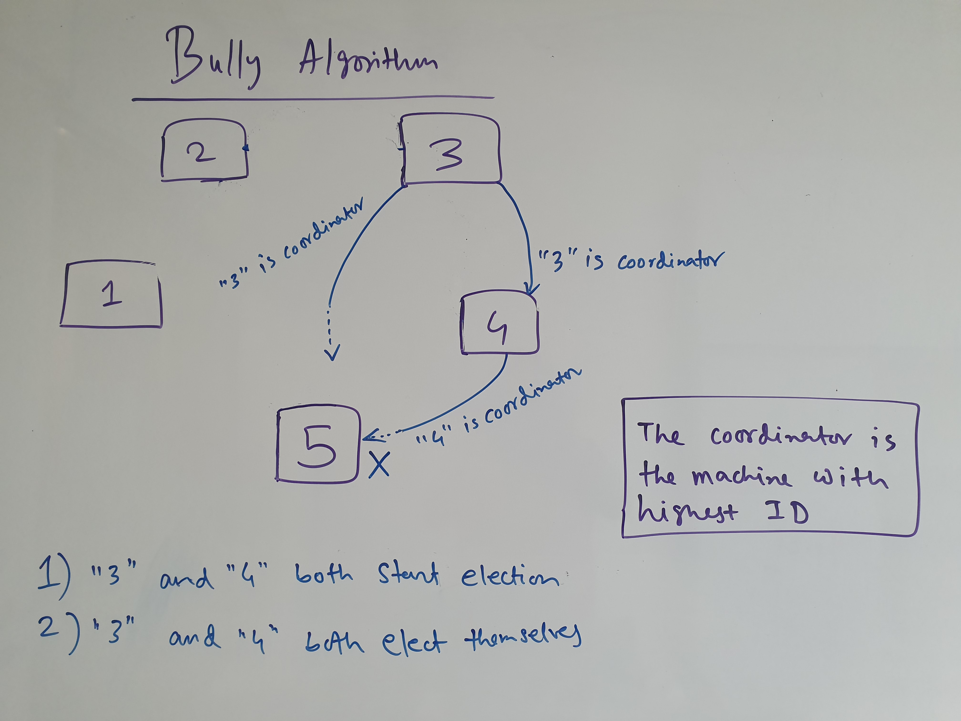

Slide 16
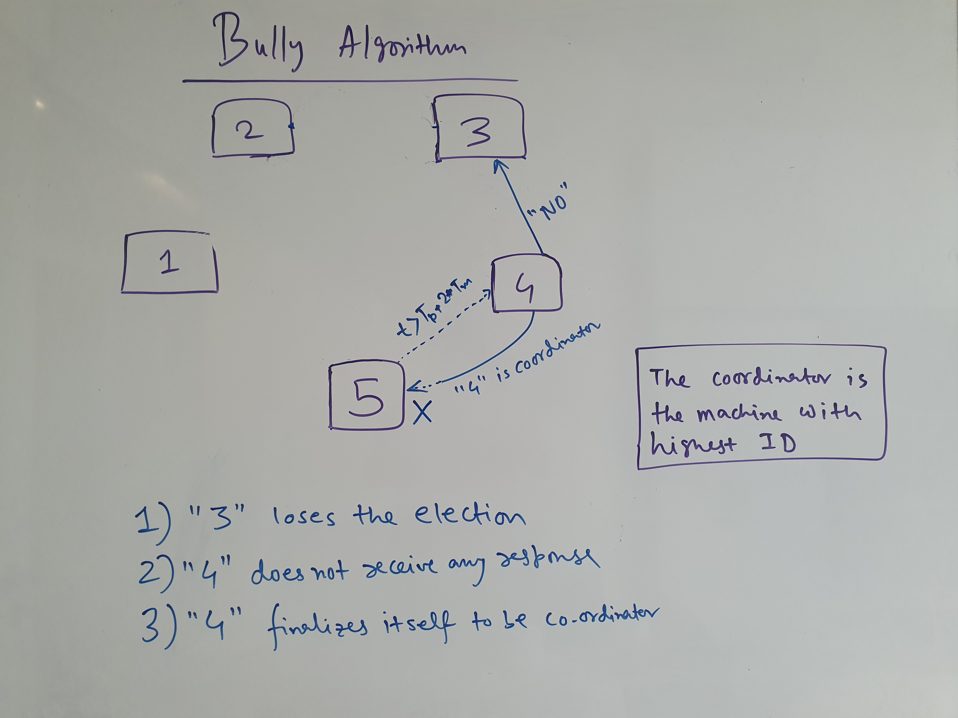

Slide 17
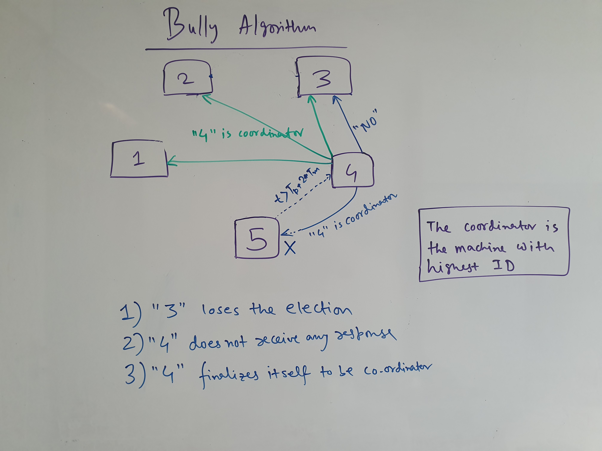

Slide 18
Bully Algorithm (Protocol)
What happens if coordinator fails before broadcast?
Another node will call for a new election

Slide 19
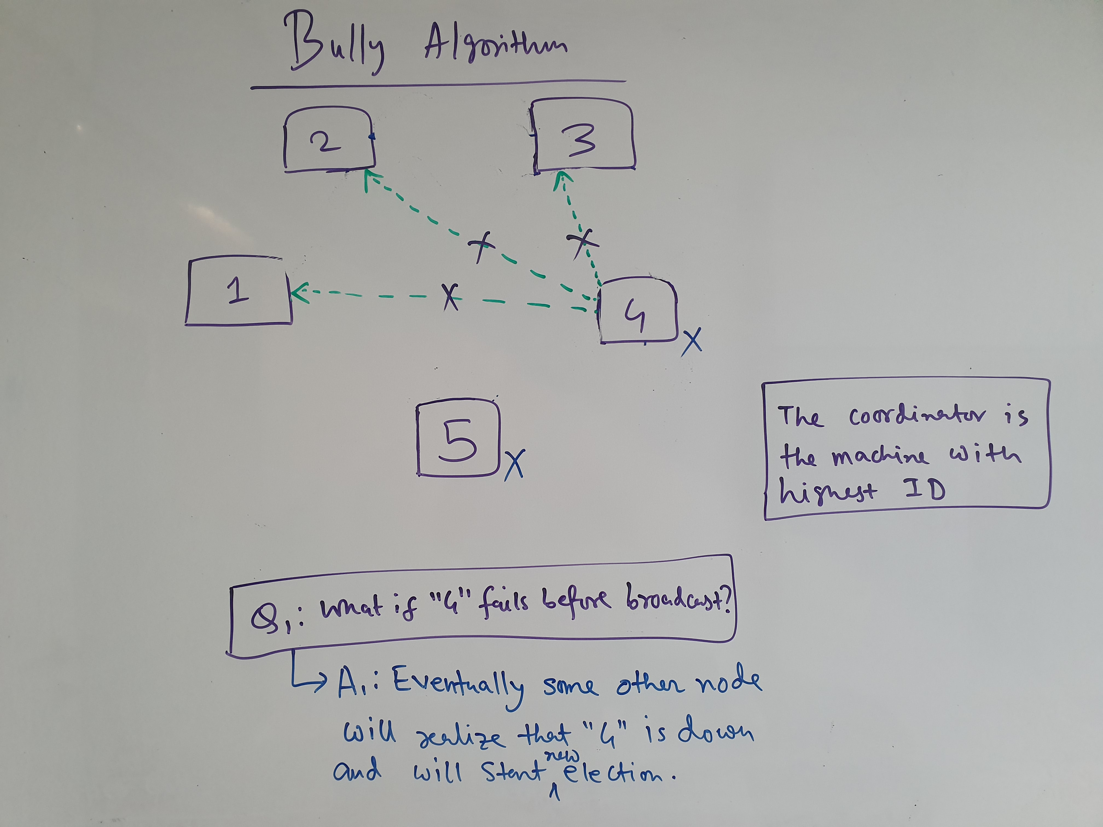

Slide 20
Bully Algorithm (Protocol)
What happens when a new process joins the network or recovers from a failure?
New process calls for a new election

Slide 21
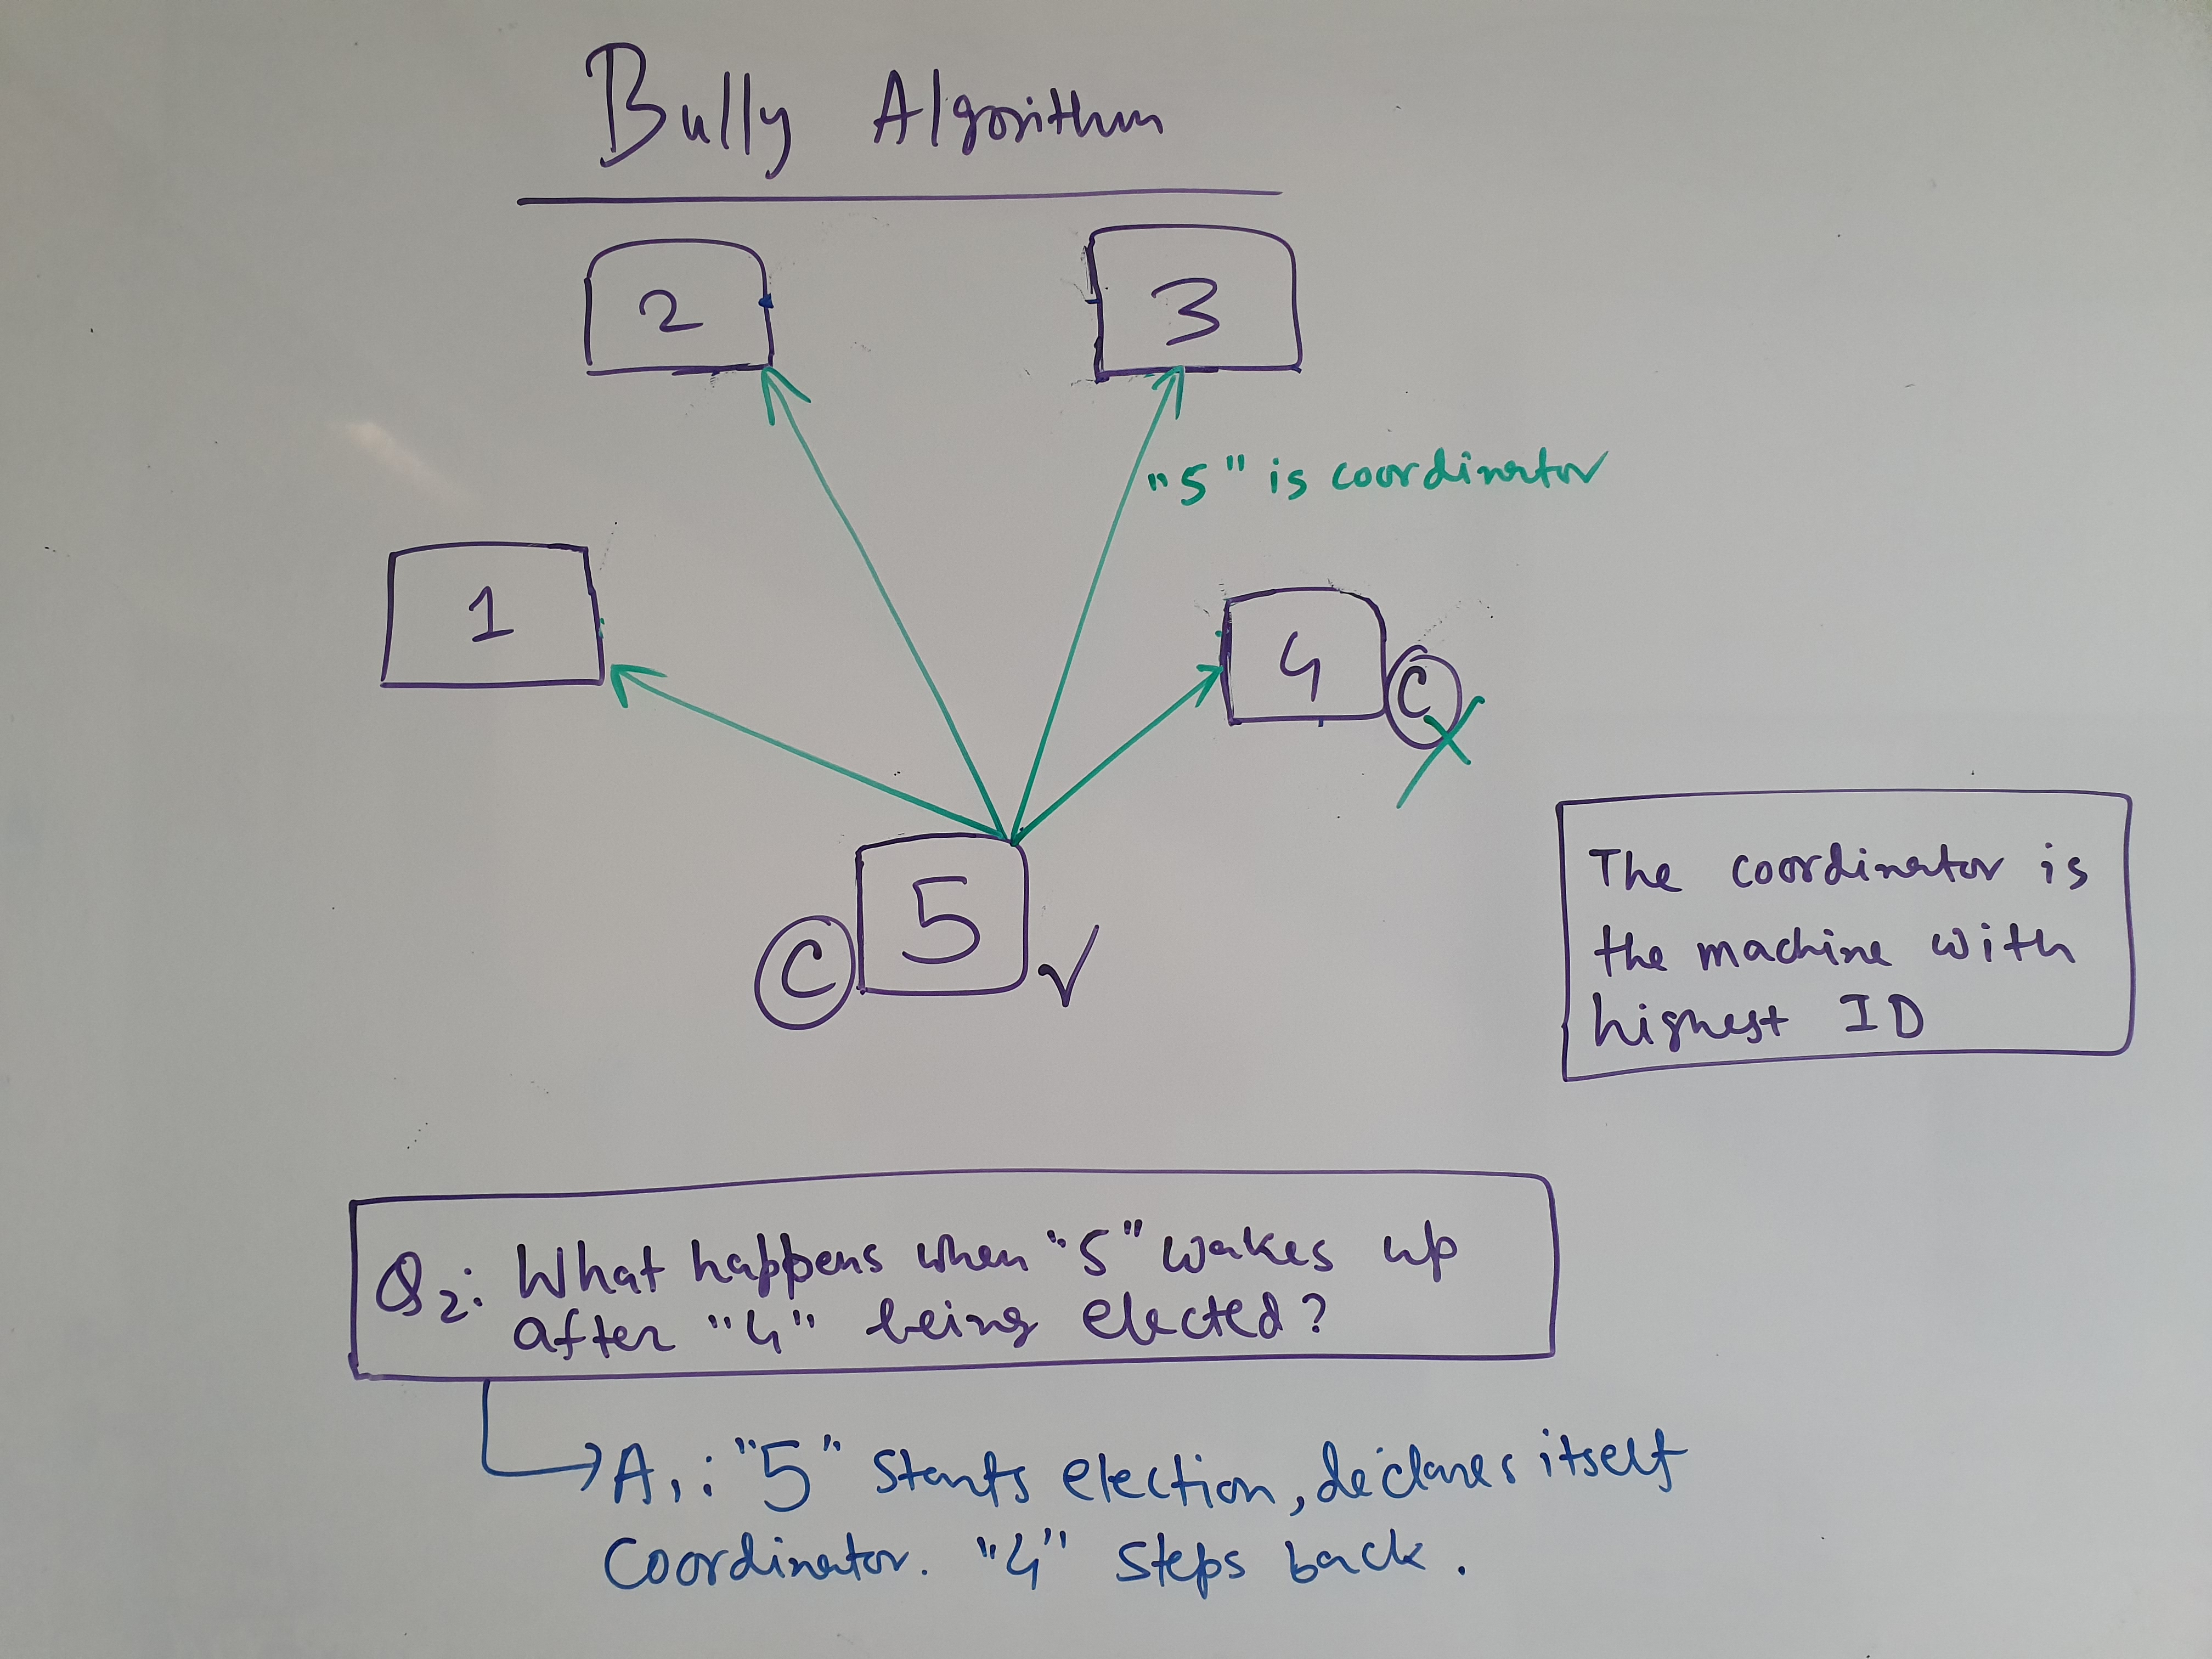

Slide 22
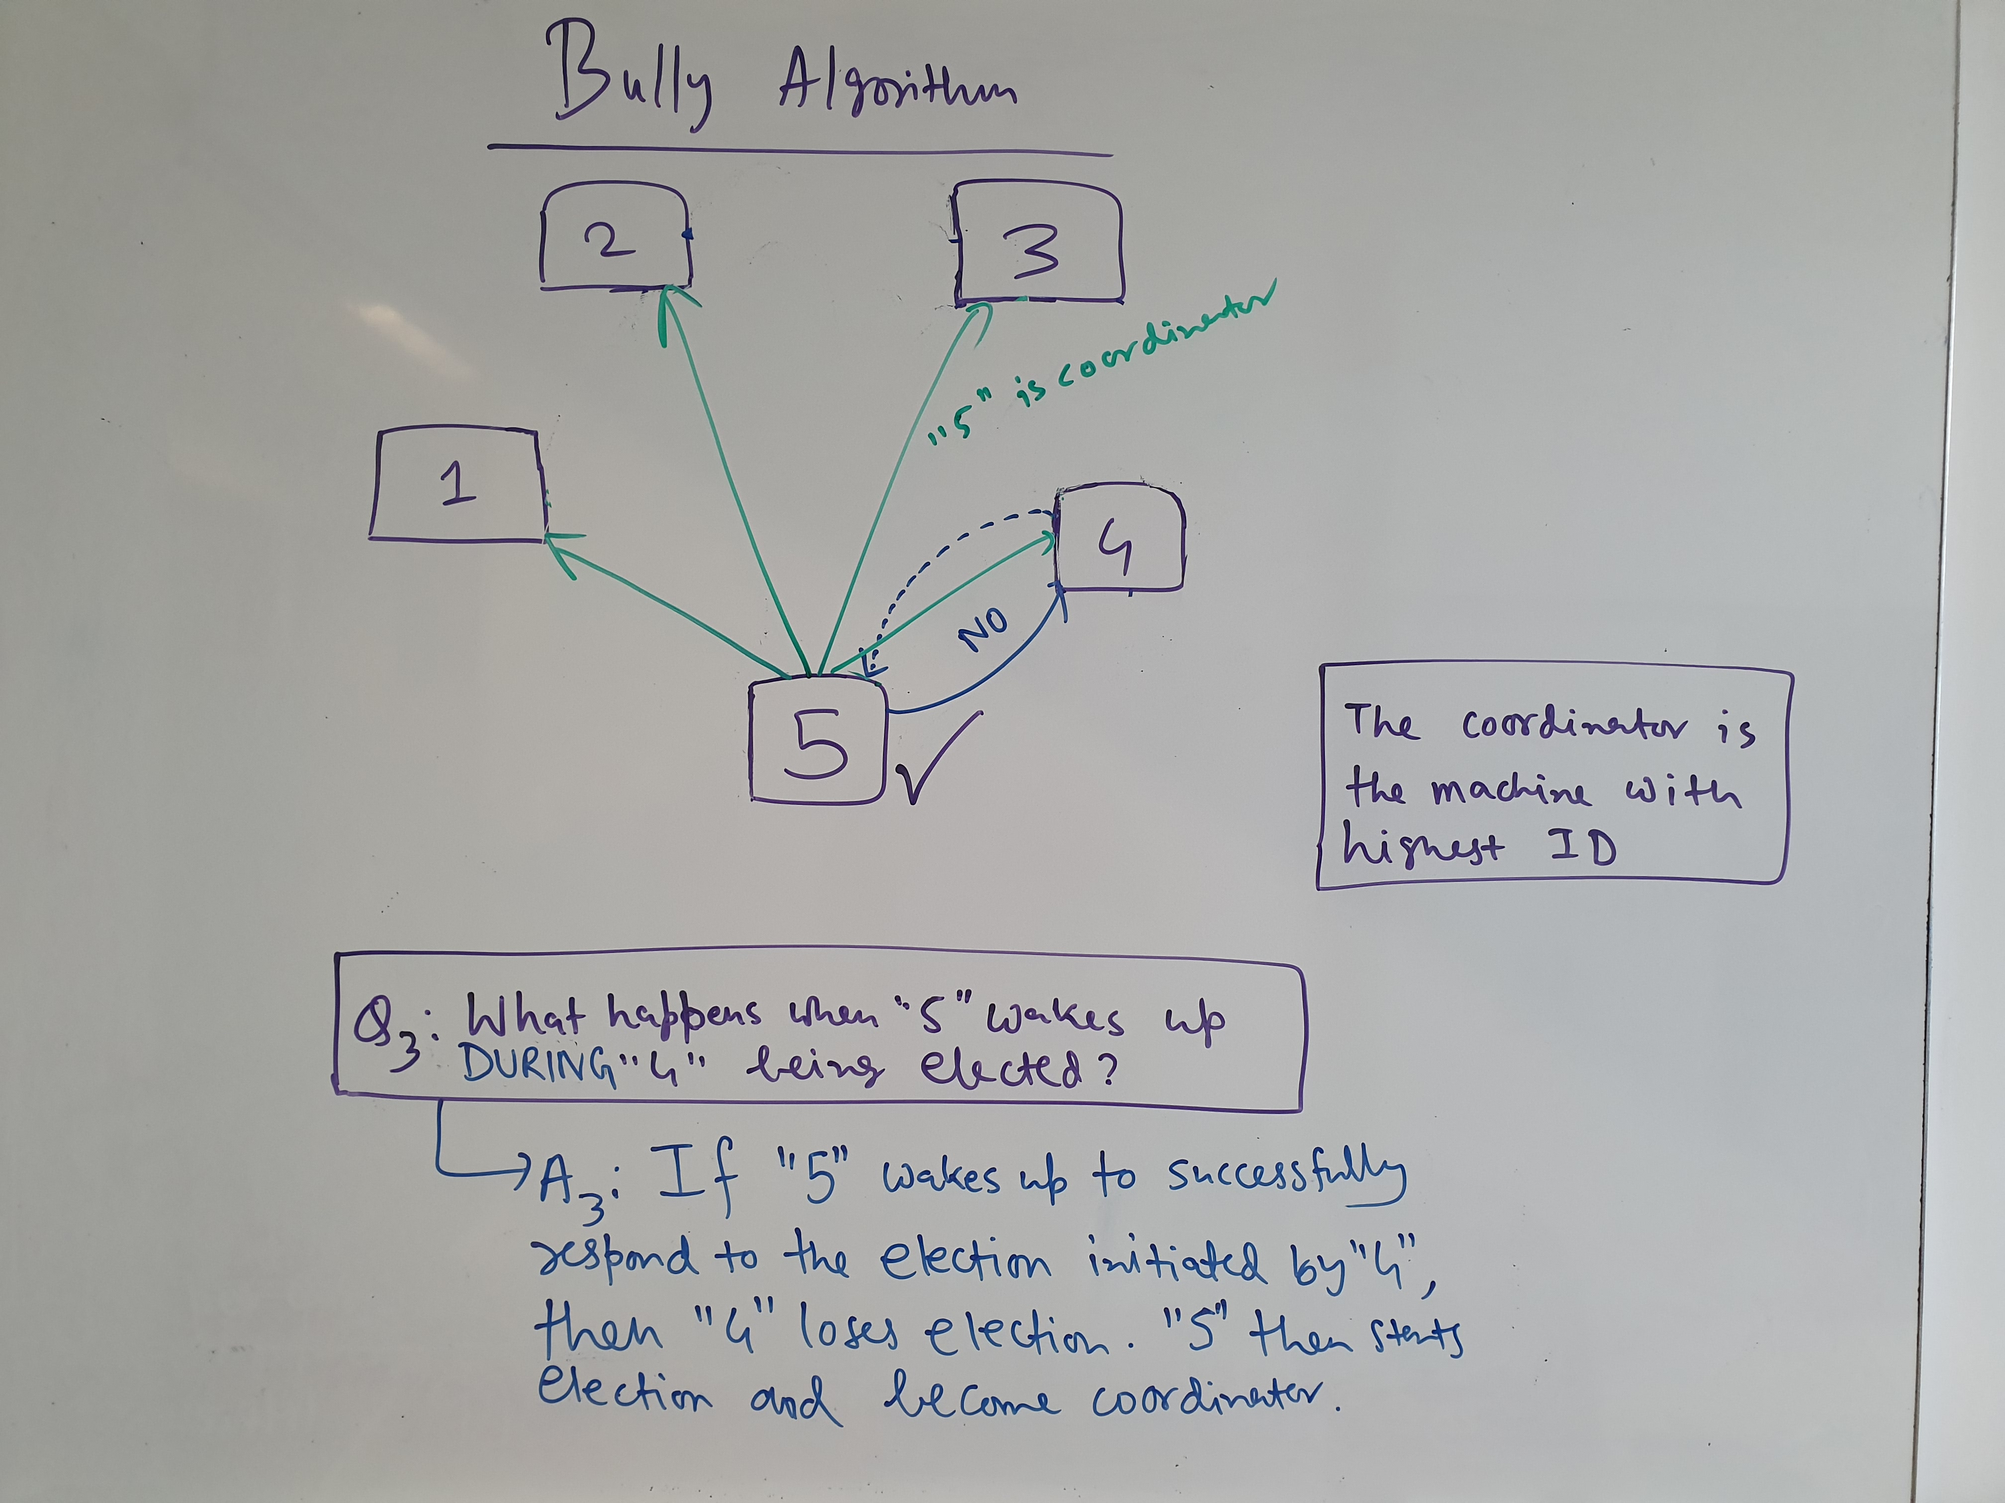

Slide 23
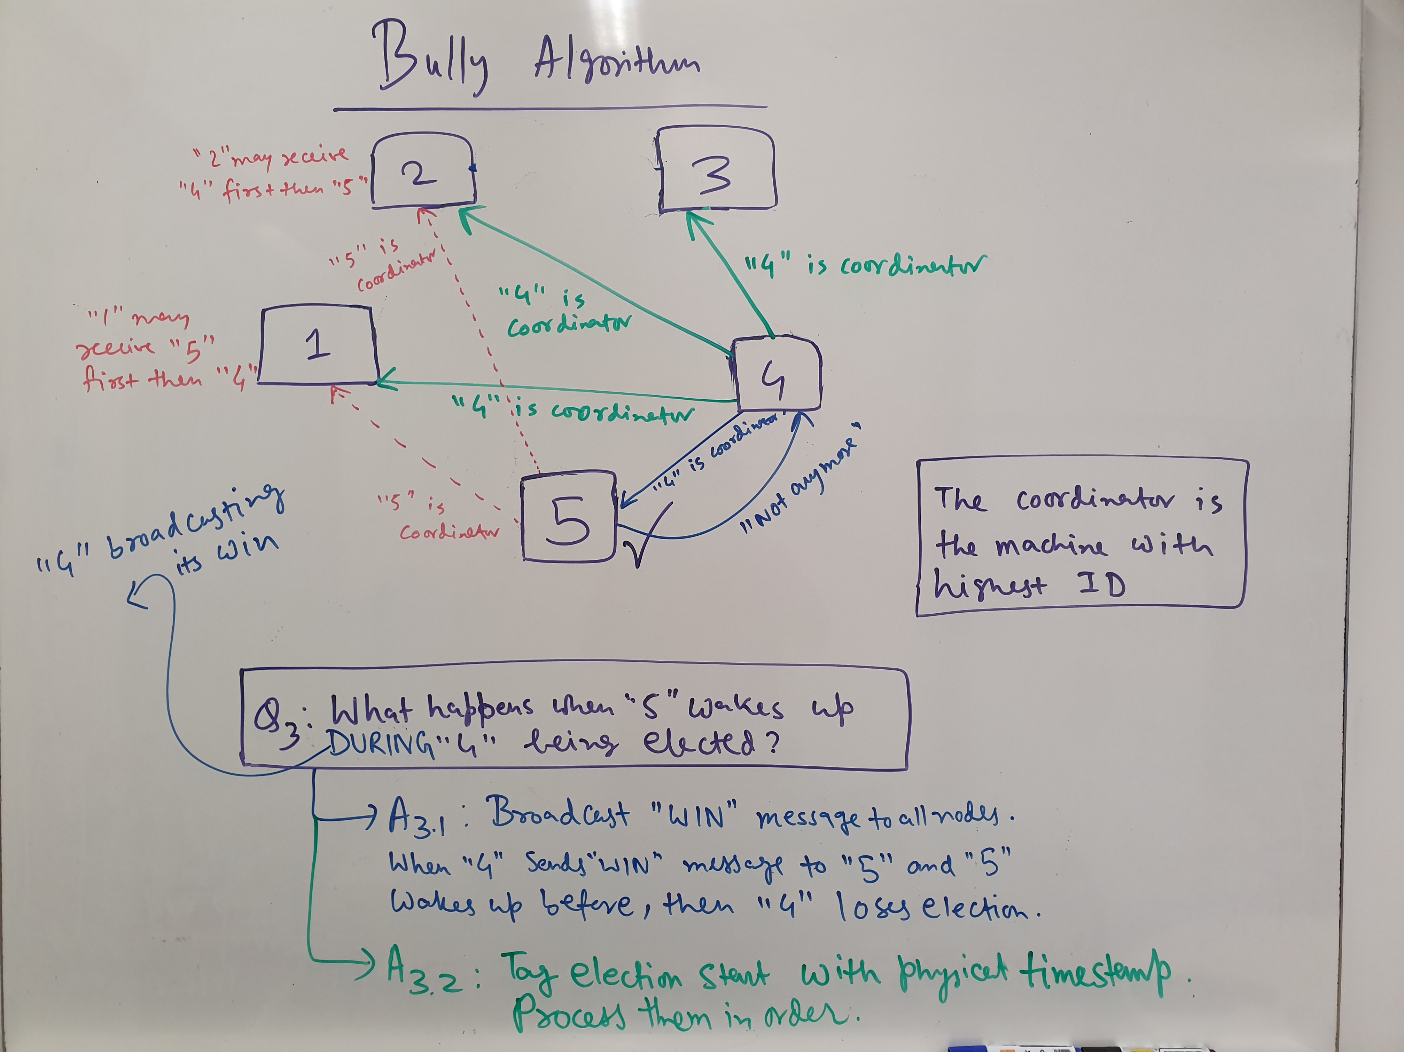

Slide 24
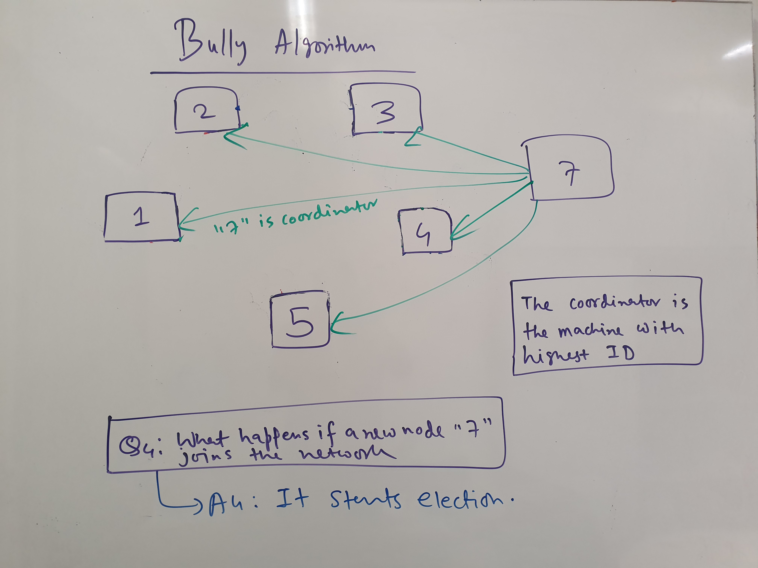

Slide 25
Bully Algorithm (Complexity)
How many messages passed?
Best case: O(n)
Worst case: O(n^2)

Slide 26
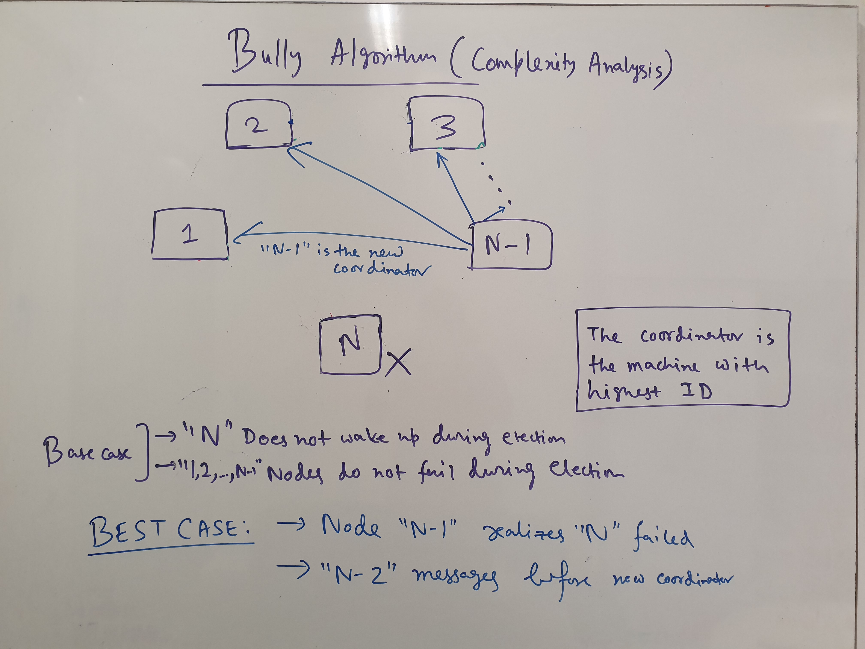

Slide 27
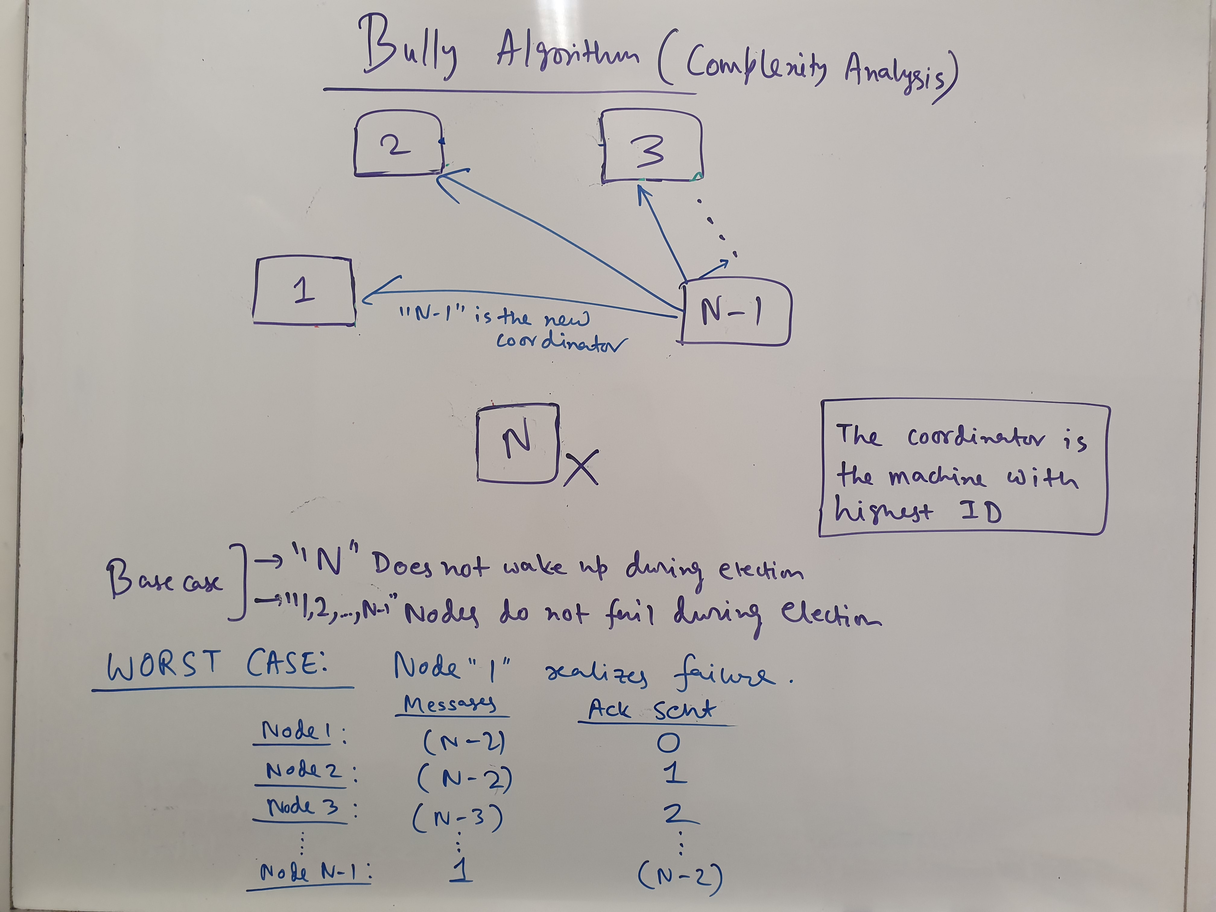

Slide 28
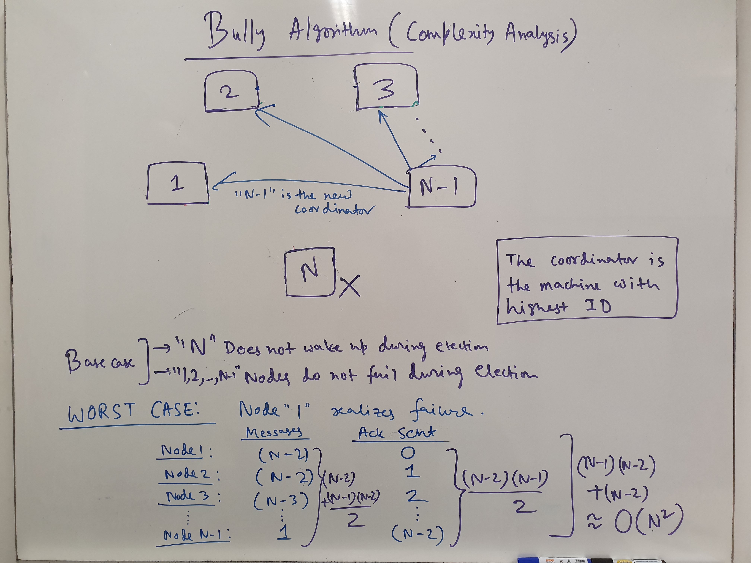

Slide 29
Bully Algorithm (Issues)
Assumes that T(m) and T(p) are known. Thus, from the timing, it can figure out whether a machine or node has failed or not.
Such assumptions might be unrealistic, as congestion, load, and the indeterminate nature of most networks may violate such assumptions.

Slide 30
Ring Election
Processors are logically connected as a ring.
Each processor in the ring is logically ordered. Thus, each processor in the network must know its successor, its successor’s successor etc.
Thus, each processor is aware of the entire logical structure.

Slide 31
Ring Election (Protocol)
(Initiation) A node realizes that the coordinator has failed (e.g., by trying to communicate with the coordinator).

Slide 32
Ring Election (Protocol)
(Election Start) After realizing that the coordinator has failed, a node passes an election message with its ID around the ring.
The election message is passed to its successor.
However, if the successor has failed, it is skipped and the message is sent to successor’s successor and so on.

Slide 33
Ring Election (Protocol)
(Reception of an Election message) After receiving an election message, a machine appends its own ID and passes the modified election message around the ring.

Slide 34
Ring Election (Protocol)
(Detecting whether the message traversed the entire ring) Once an election message is received and if the receiver machine finds its own ID in the message, then we conclude that the message had made its way all around the ring.

Slide 35
Ring Election (Protocol)
(Choosing the Coordinator) Once an election message had made its way all around the ring, the machine with the highest ID is chosen as the coordinator.
At this point, the coordination message is passed similarly around the ring.

Slide 36
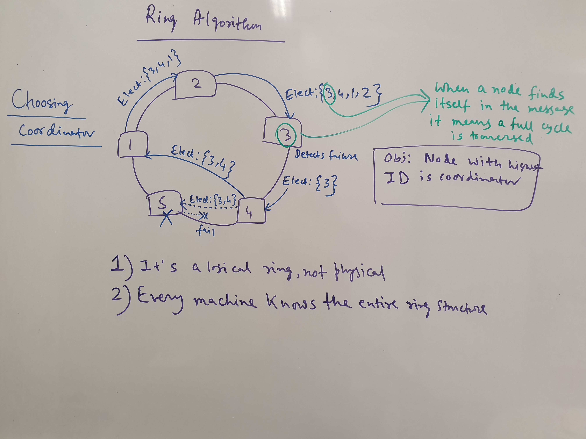

Slide 37
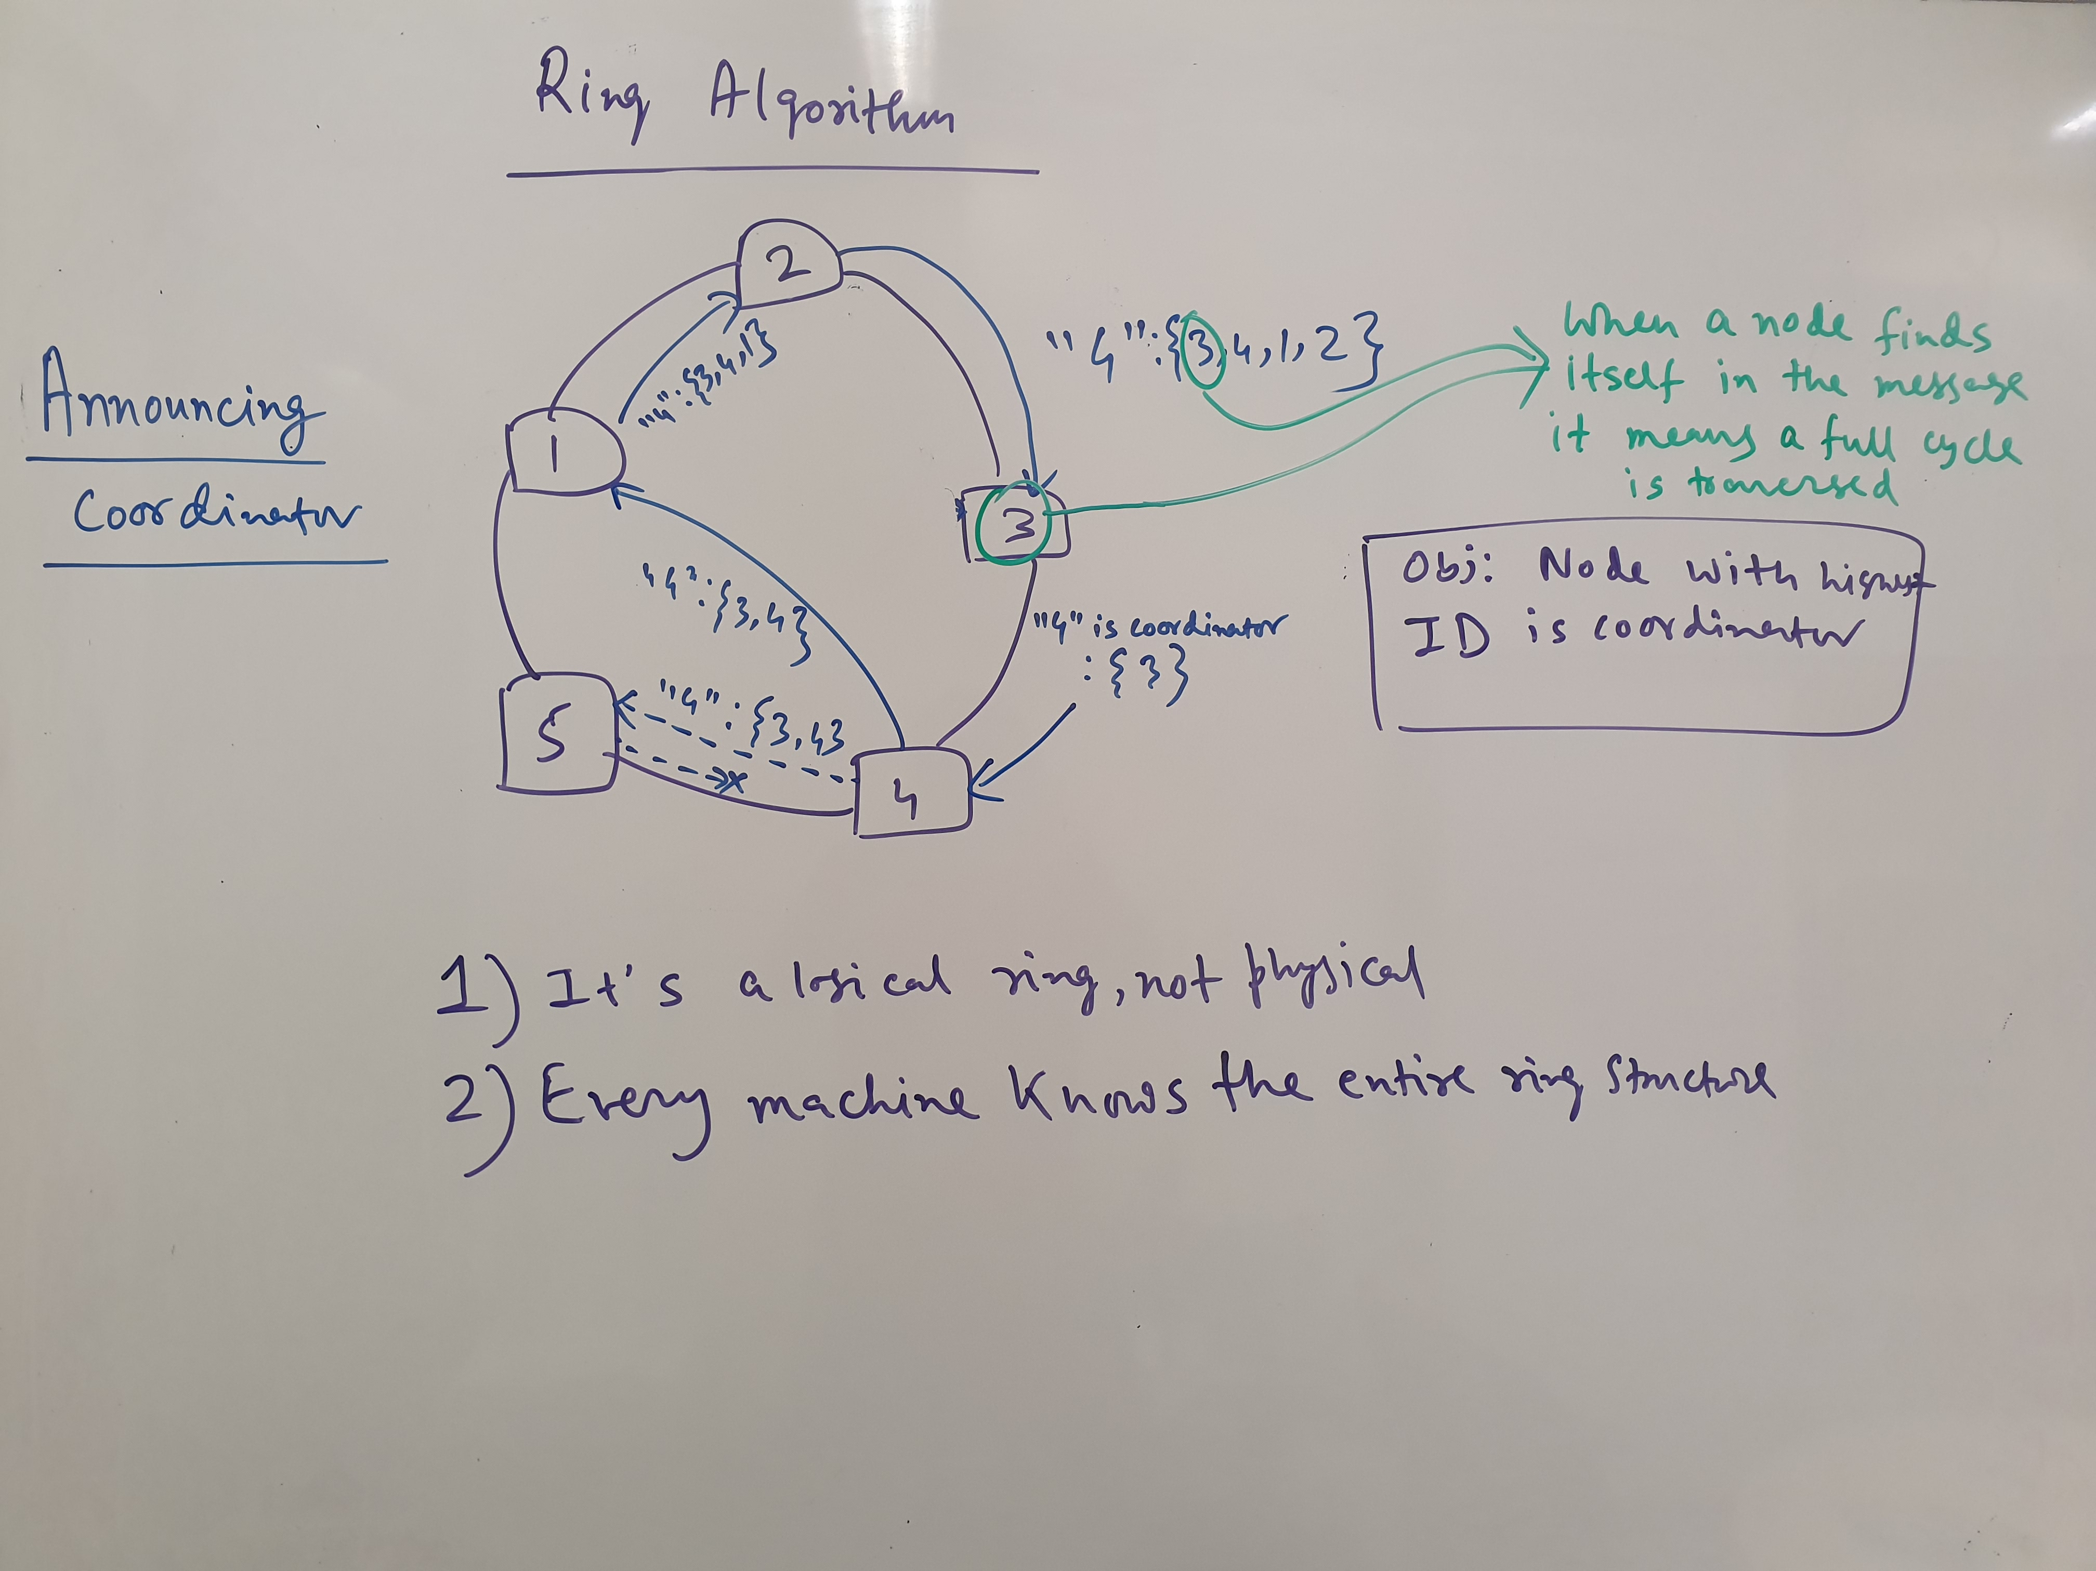

Slide 38
Ring Algorithm (Protocol)
What happens when a new process joins the network or recovers from a failure?
Reconfiguration of ring structure, know where to place itself at (no arbitrary order)
New process calls for a new election

Slide 39
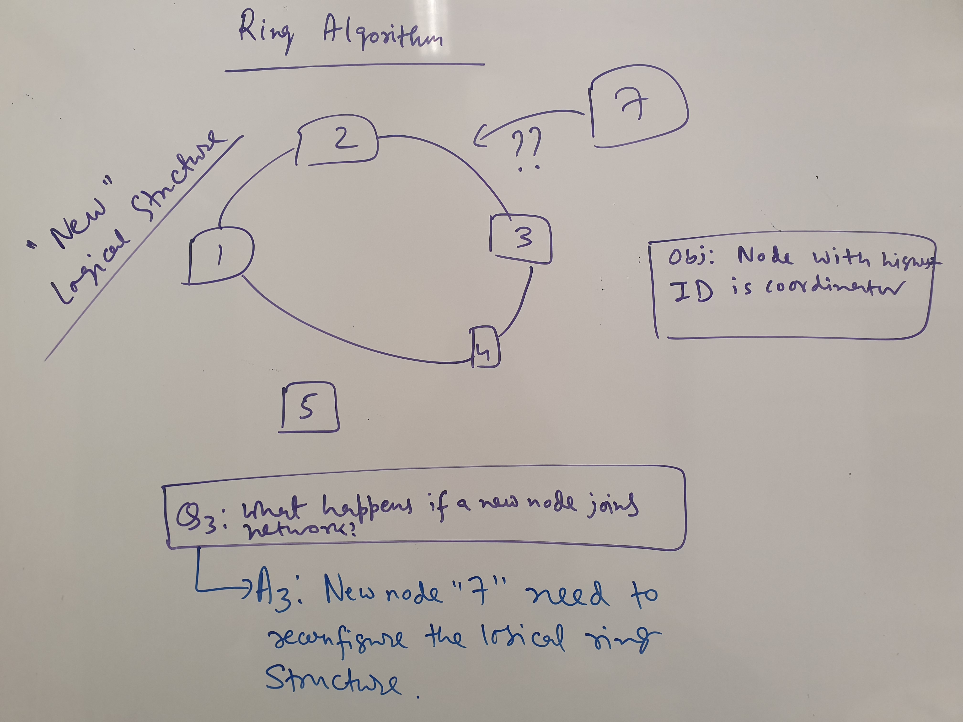

Slide 40
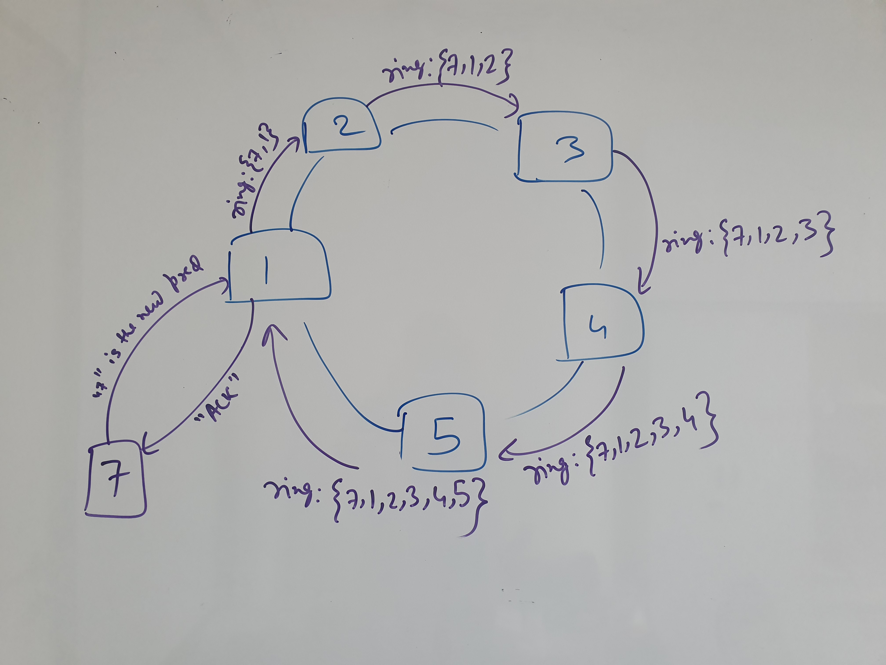
Notes:
No idea what p><d is. Definitely not English

Slide 41
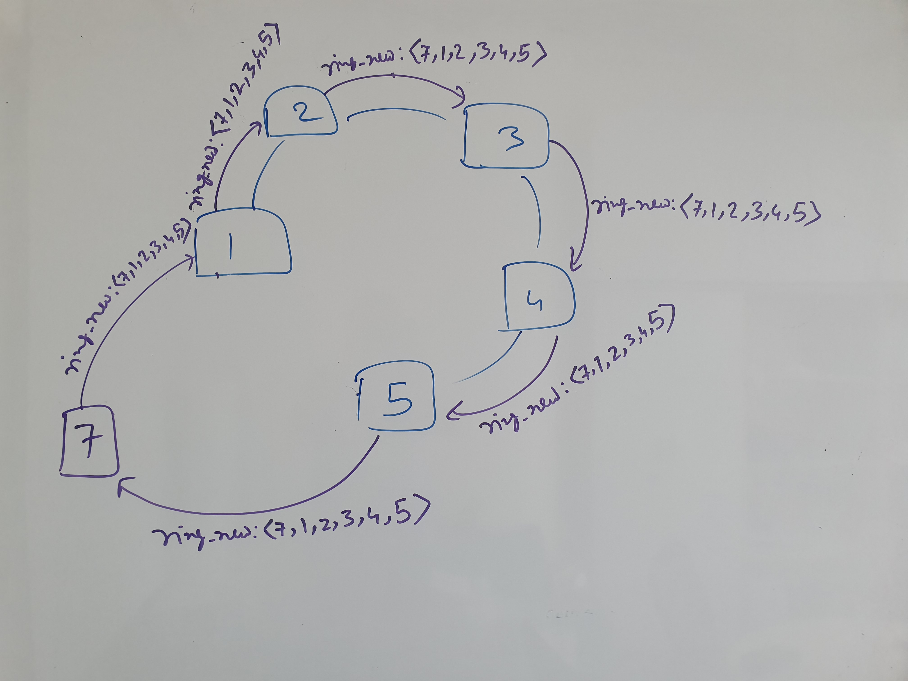

Slide 42
Bully Algorithm (Protocol)
What happens if coordinator wakes up during coordination?
Another node will call for a new election

Slide 43
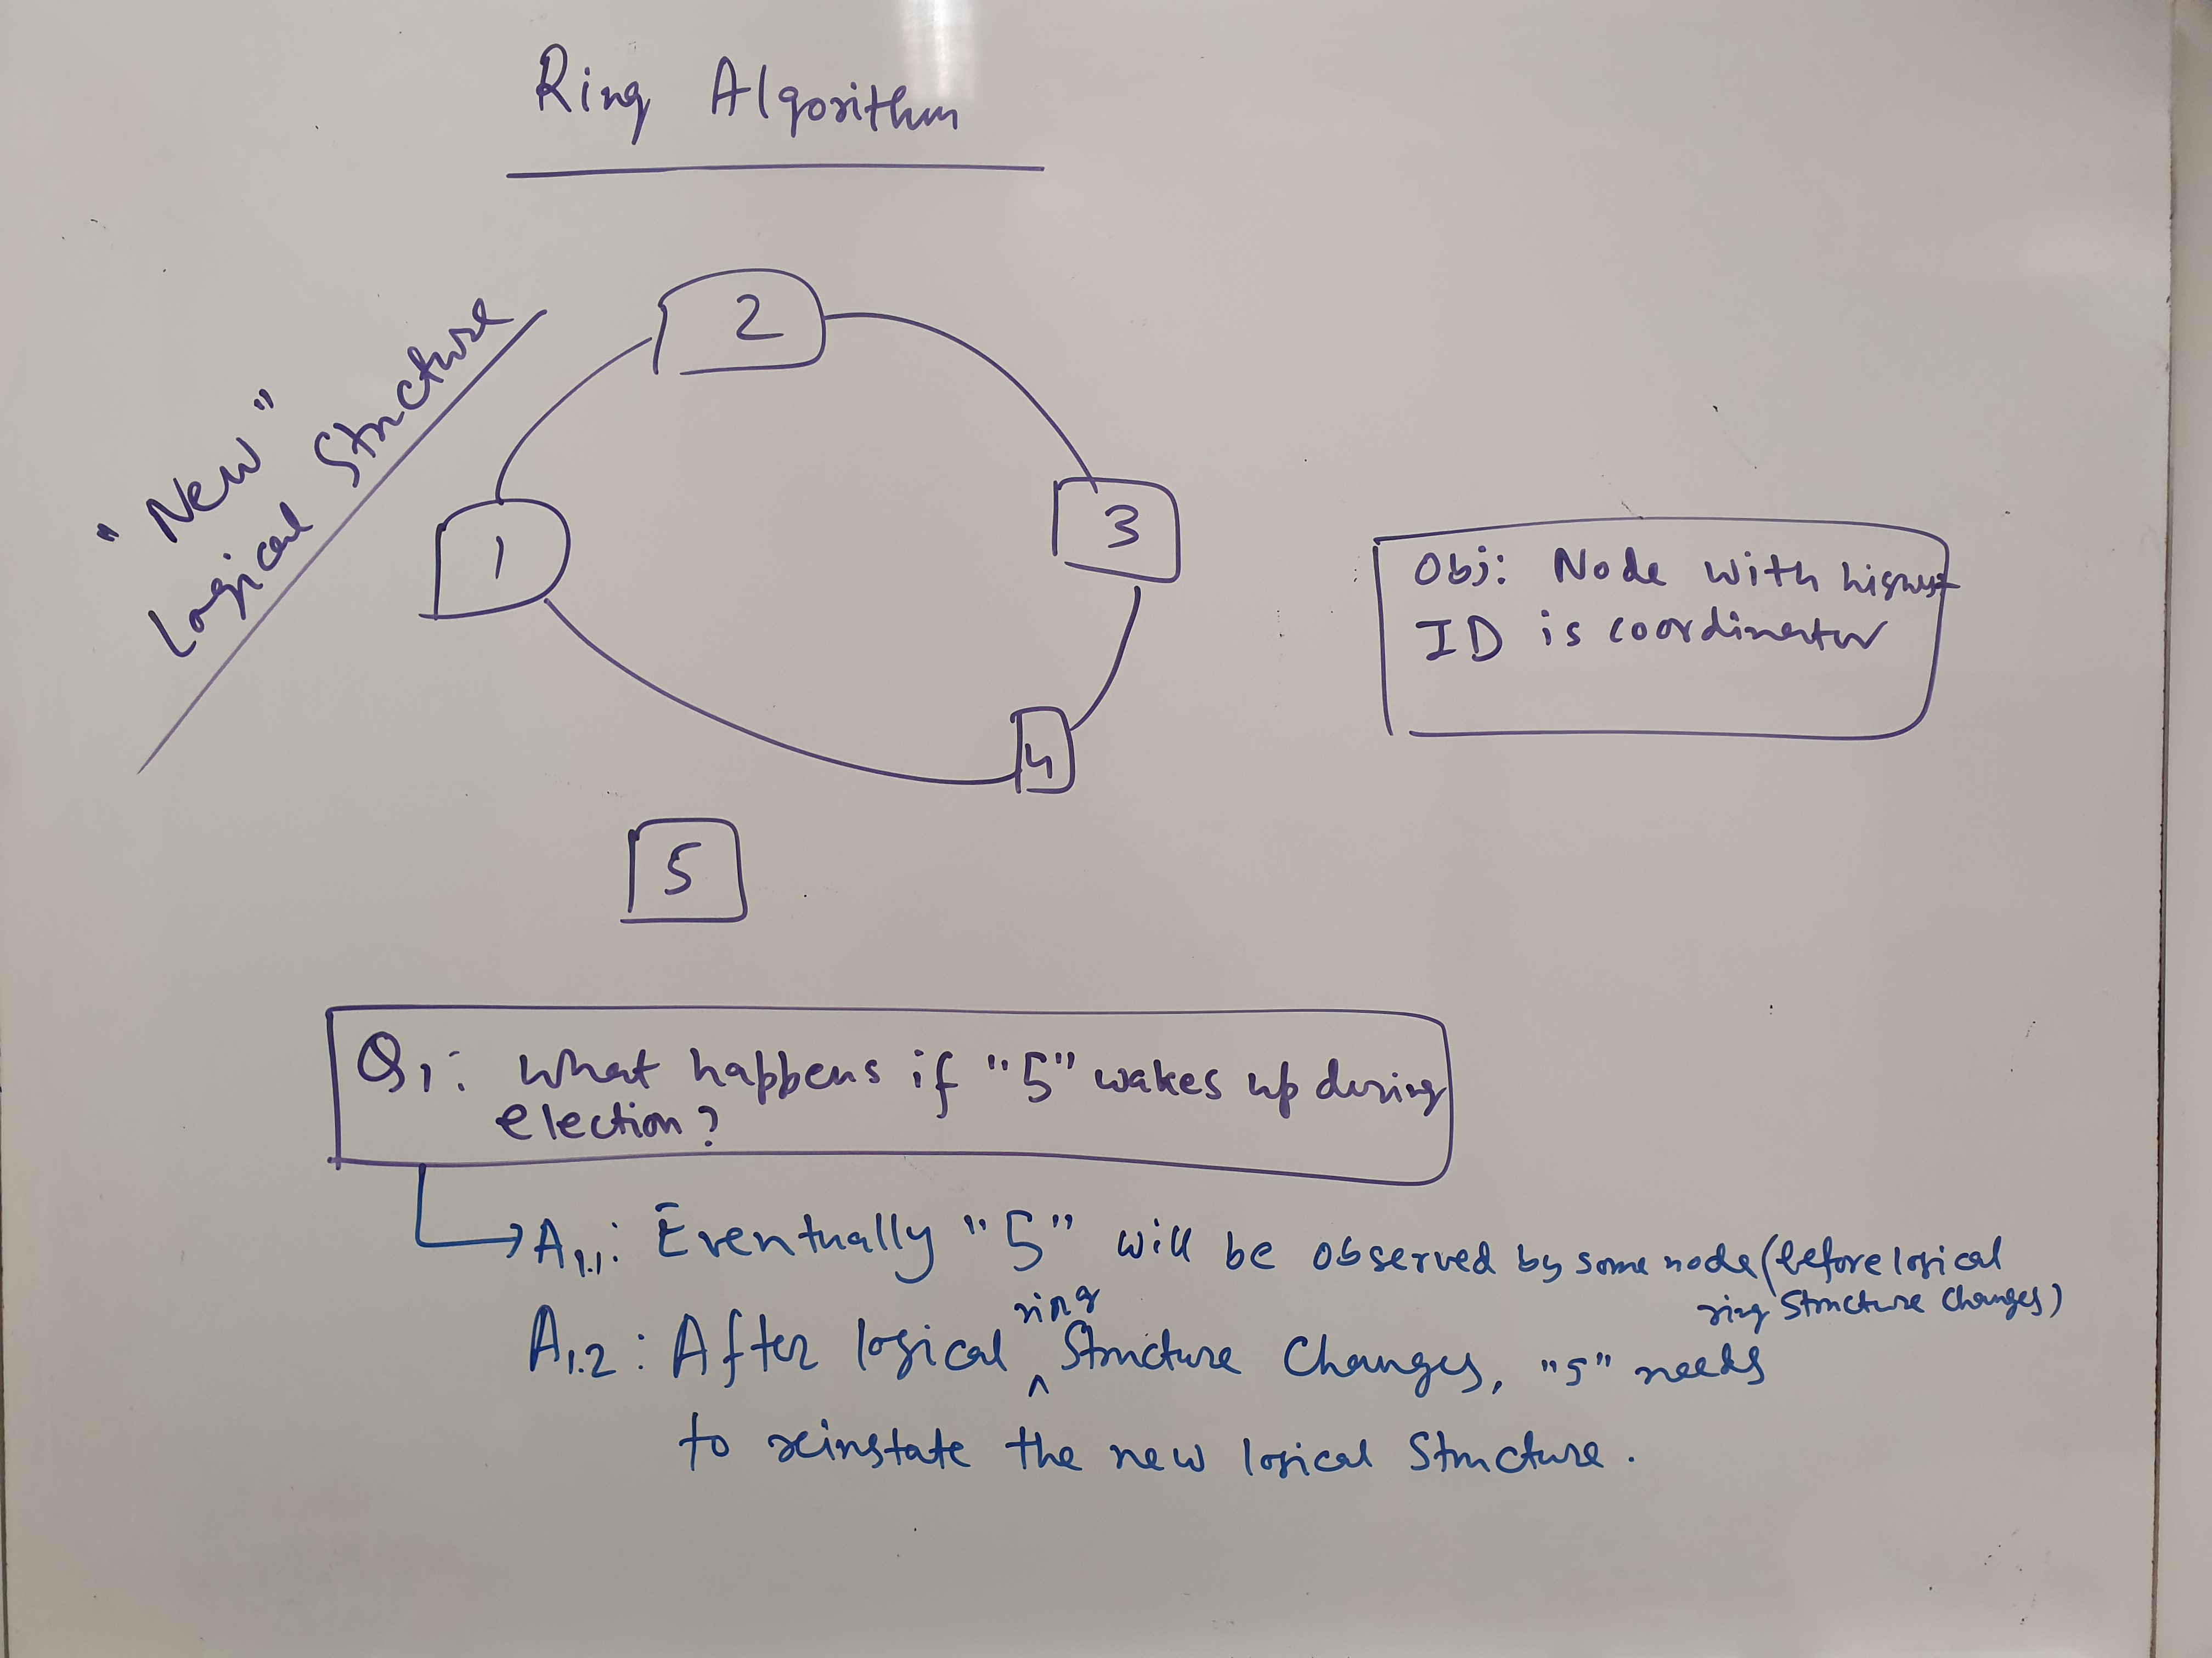
Notes:
Essentially do the same thing as how 7 joins in the previous slide, needs to reinstate new structure

Slide 44
Bully Algorithm (Protocol)
What happens if a node fails during coordination/message passing?
Start new election again to establish ring structure

Slide 45
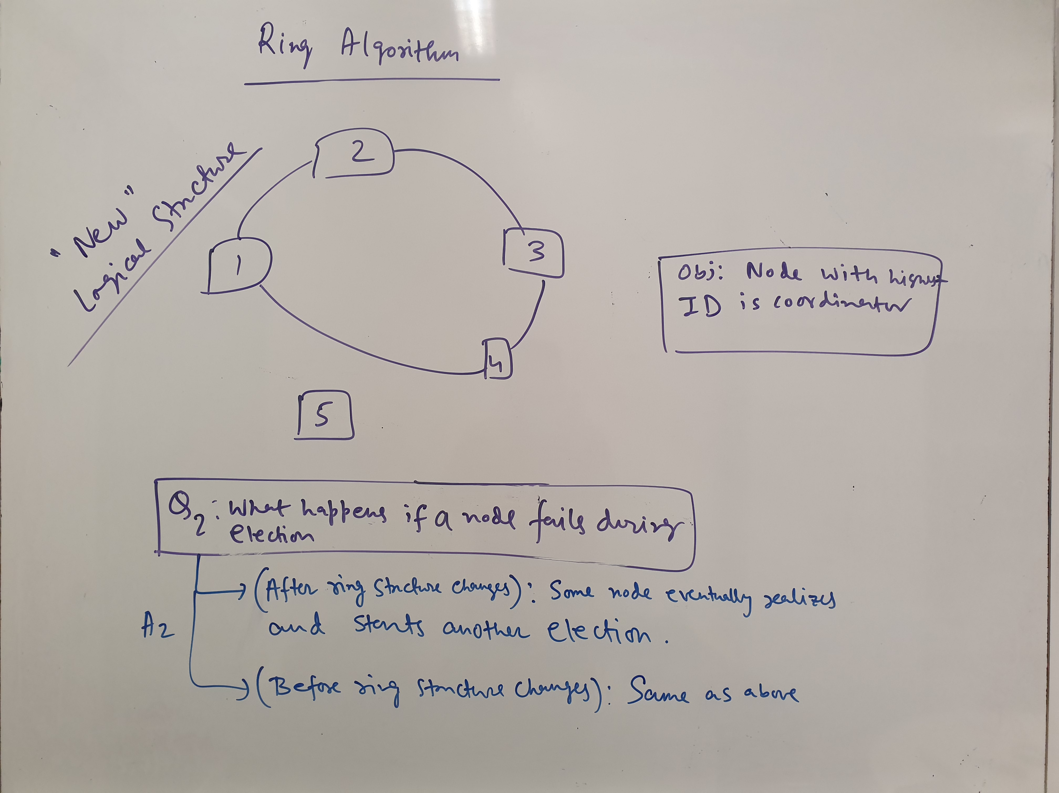

Slide 46
Bully Algorithm (Protocol)
What happens if there are multiple detections?
Messages passed around increases
Complexity analysis
Best case: O(n)
Worst case: O(n^2)

Slide 47
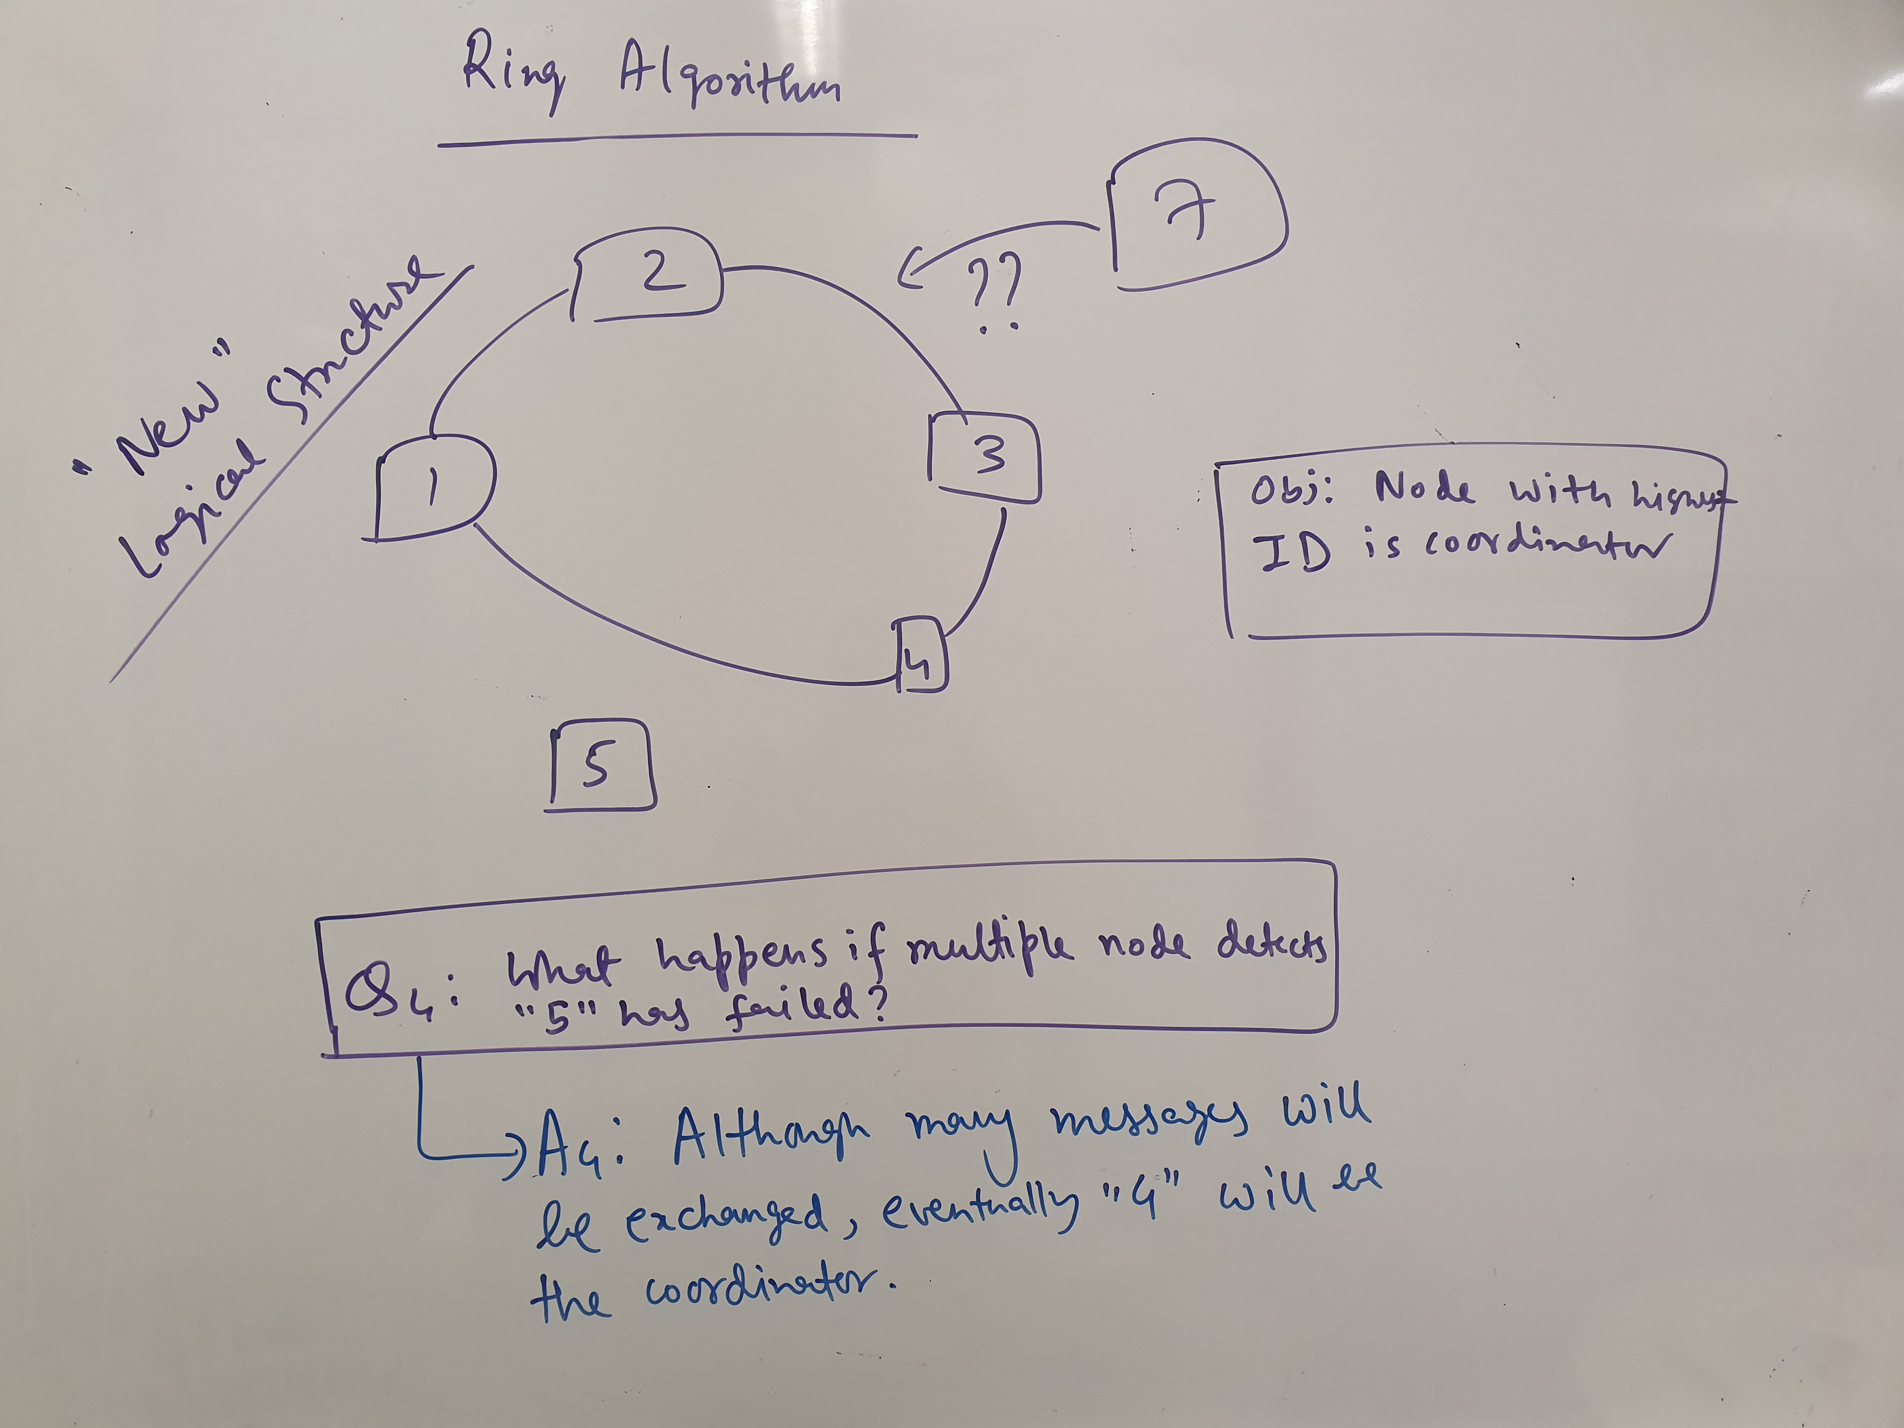

Slide 48
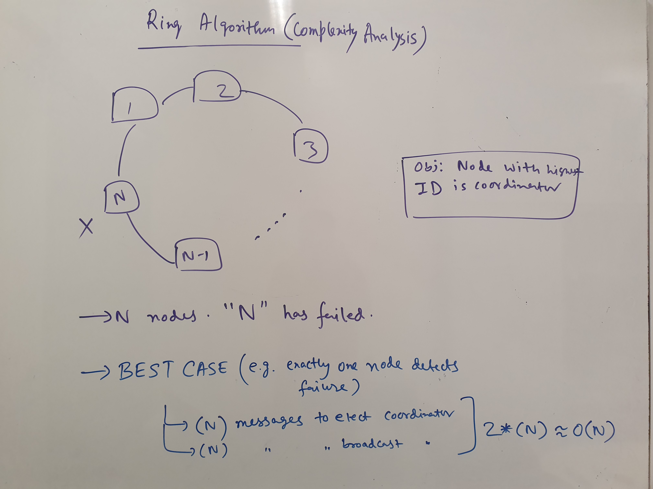

Slide 49
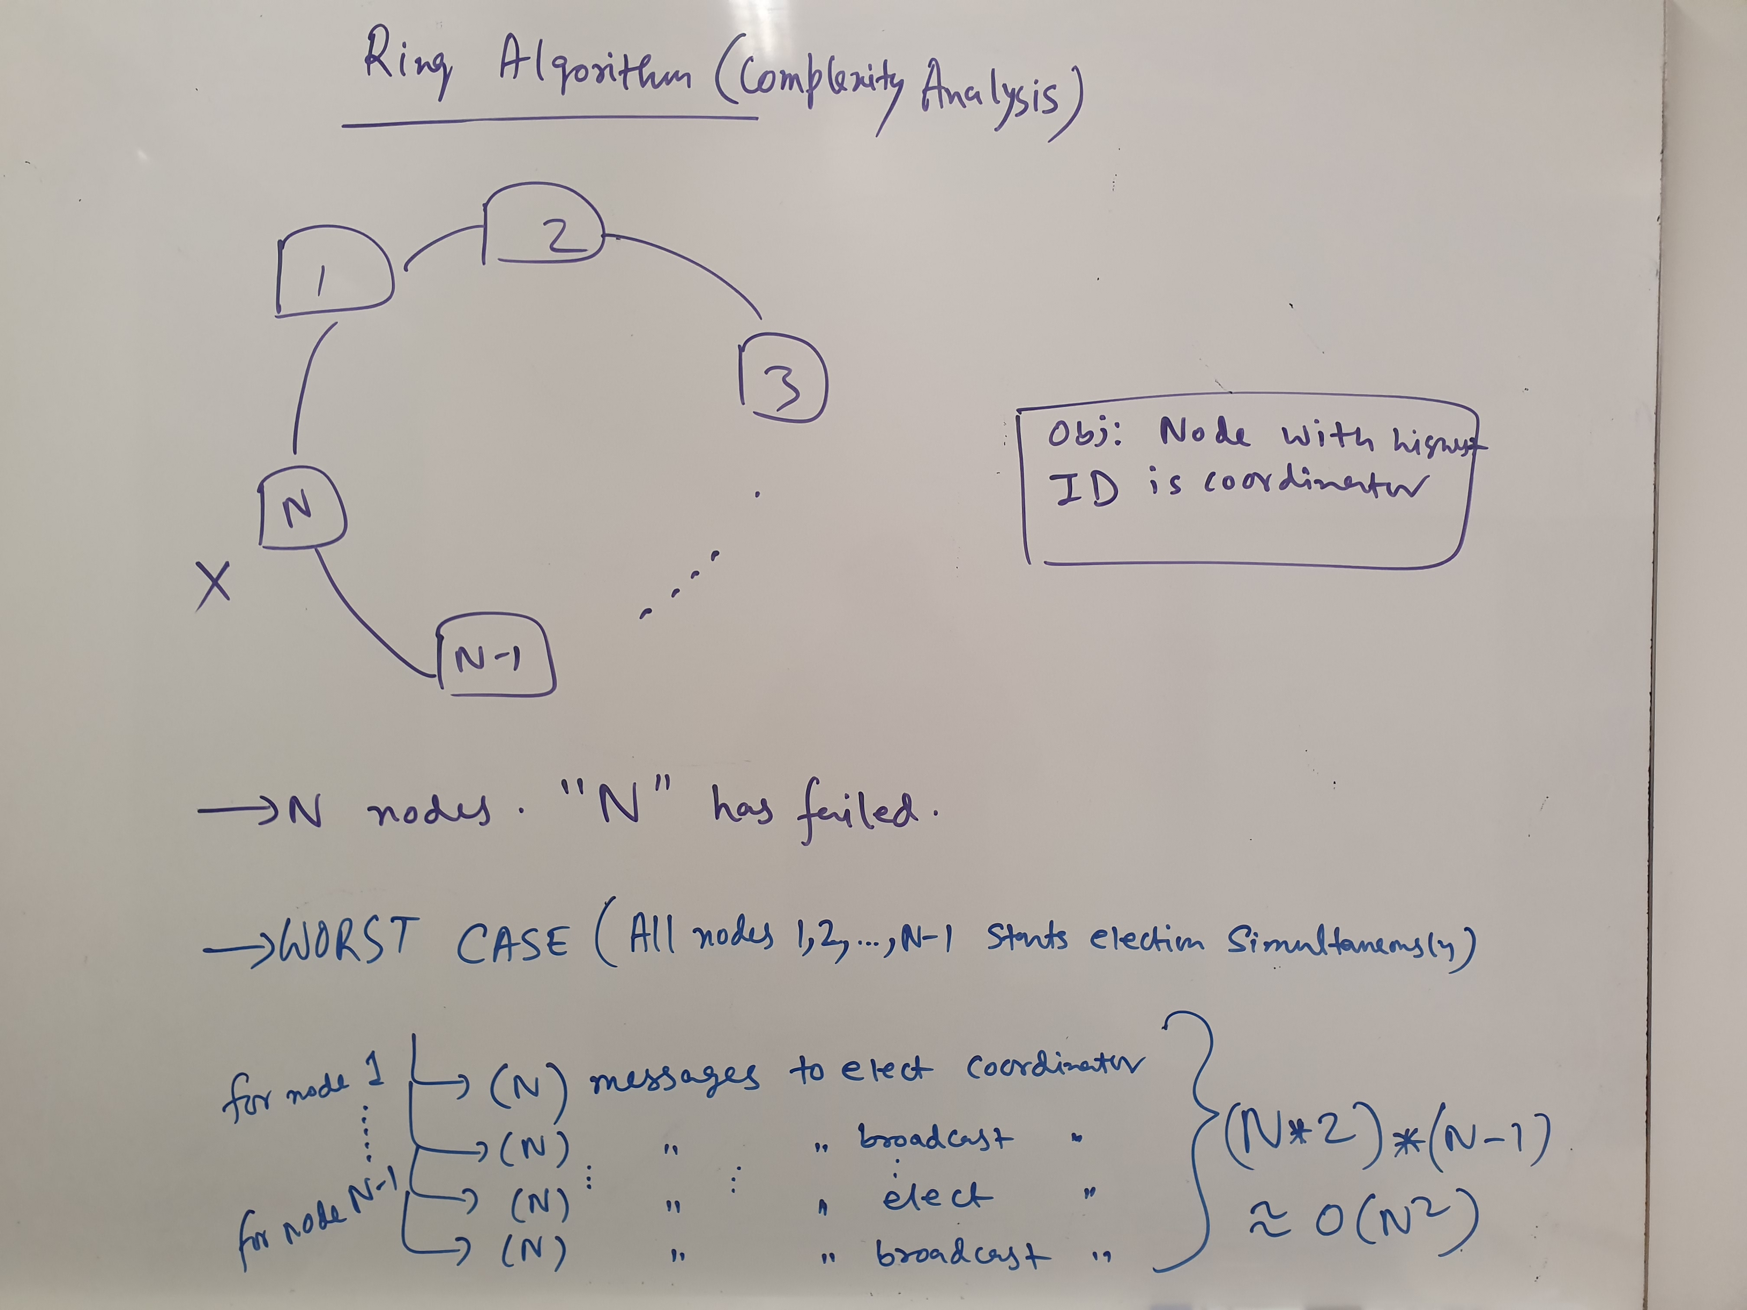

Slide 50
Invitation Algorithm
In practice communication failure, high latency, and/or congestion can partition a network. We can assume that a collection of machines, under the direction of a coordinator, can perform useful work, even if other such groups exist.
Thus, we have an arrangement such that each group of machines that can communicate among themselves is directed by a coordinator.
Different groups of processors, each operating under the direction of a different coordinator, can co-exist.

Slide 51
Network Partitions
1
3
1
3
2
4
2
4
All nodes 1,2,3,4 are in the same partition, thus only one coordinator for (1,2,3,4).
All links between (1,2) and (3,4) are down
or heavily congested. Thus, creates virtually two network partitions.
How to elect coordinators with such evolving partitions?

Slide 52
Invitation Algorithm
The Invitation Algorithm provides a protocol for forming groups of available machines within network partitions, and then creating larger groups as failed machines are returned to service or network partitions are rectified.

Slide 53
Invitation Algorithm (Protocol)
(On failure of coordinator) A node realizes that the coordinator has failed, elects itself as the coordinator and broadcasts the coordinator message to all other reachable nodes.

Slide 54
Network Partitions
1
3
2
4
All links between (1,2) and (3,4) are down
or heavily congested. Thus, creates virtually two network partitions.
Assume node 1 realizes that node 4 has failed.
But note that the partitions are yet to be known by all nodes.

Slide 55
Invitation Algorithm (Example)
1
Join me
3
Join me
2
4
Node 1 tries to create its own group

Slide 56
Invitation Algorithm (Protocol)
(On receiving a join group message) A node responds to such a message and tries to elect itself as the coordinator similarly.
If a response is received from a higher ID machine, then the machine starting the election process retires.

Slide 57
Invitation Algorithm (Example)
1
Join me
3
Join me
Ack
2
4
Node 3 never responds and Node 1 retires after receiving response from 2.

Slide 58
Invitation Algorithm (Example)
1
3
Join me
Join me
2
4
Join me
Node 2 elects itself as the coordinator and asks others to join his group.

Slide 59
Invitation Algorithm (Example)
1
3
Join me
OK
Join me
2
4
Join me
Node 3 and 4 never respond, but node 1 does.
At this stage partition (1,2) is formed. Likewise, (3,4) partition
is formed.

Slide 60
Invitation Algorithm (Protocol)
Periodically coordinators look for other coordinators. If they find other coordinators, they invite them to merge into a new partition.
If they accept the invitation, the coordinators tell their participants to move into the new group and move into the new group themselves. In this way, groups can be merged into a single group.

Slide 61
Invitation Algorithm (Example)
1
3
Are you a coordinator?
2
4
Node 2 and 4, being coordinators periodically look for
other coordinators.

Slide 62
Invitation Algorithm (Example)
1
3
Are you a coordinator?
No
Are you a coordinator?
2
4
yes
Node 2 and 4, being coordinators periodically look for
other coordinators. Since the network is repaired, node 4
can receive response from 1. Likewise, 2 can receive response from 4

Slide 63
Invitation Algorithm (Example)
1
3
Join the group of 4
Join Me
2
4
Yes
Node 2 accepts the invitation to join the group of 4.
Concurrently, Node 2 also asks its group members to join.

Slide 64
Invitation Algorithm (Example)
1
3
Join the group of 4
Yes
2
4
Join Me
Node 2 accepts the invitation to join the group of 4.
Concurrently, Node 2 also asks its group members to join.
The network partition now contains all the nodes.

Slide 65
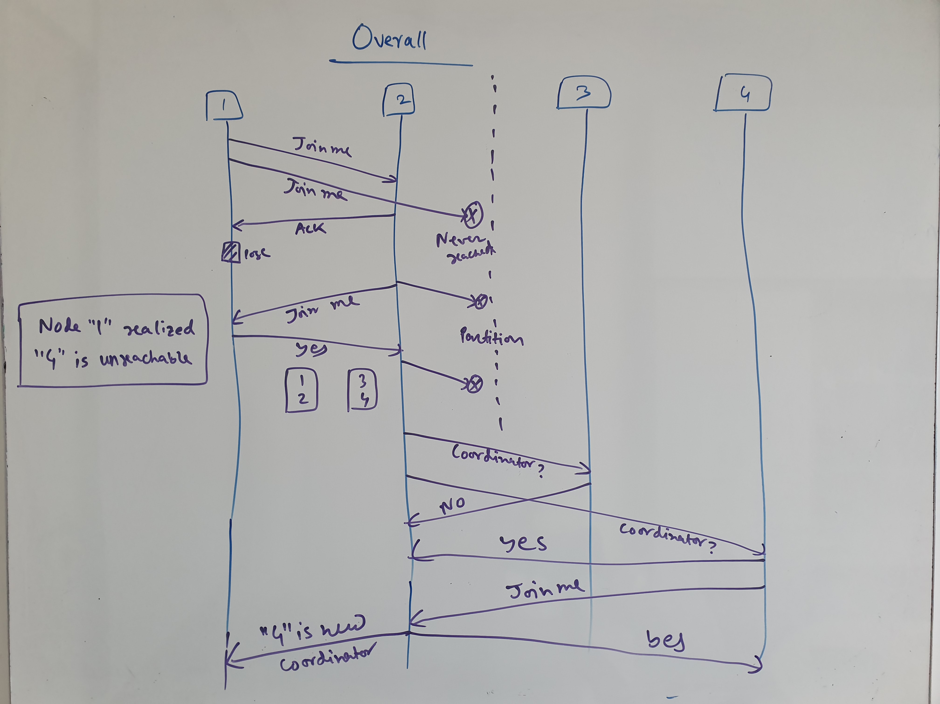

Slide 66
Invitation Algorithm (Advantage)
Partially solves the problem of detecting node unreachability, as sub-groups can work concurrently with different coordinators.

Slide 67
Invitation Algorithm (Issues)
All processing stops when the partitions are being merged.
Does not guarantee global consistency of data structures across all nodes
Consistency of data structures is only guaranteed within a partition, but not across partitions.

Slide 68
Detecting Node Failures (Issues)
Based on round trip time (RTT) beyond a threshold
If the threshold is too high
Affects performance of the overall system while electing coordinator
If the threshold is too low
May invoke coordinator election more frequently than required
More messages due to election
More than one coordinators

